Slide 1
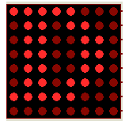
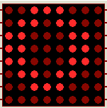
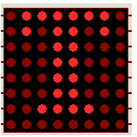
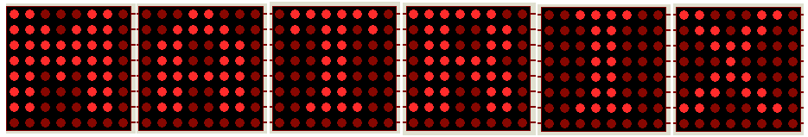

Slide 2
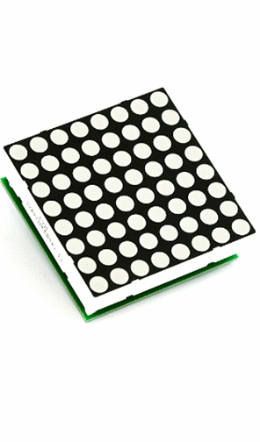
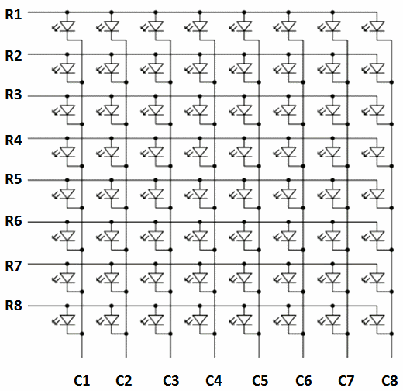
8X8 DOT MATRIX DISPLAY

Slide 3
What you should know to achieve the task
How to turn on an LED?
  LED: Light Emitting Diode
  How to show a fixed pattern on the dot-matrix display

Slide 4
How to turn on an LED
make voltage difference between the two terminals of LED
0
0
1
1
0
1
OFF
OFF
OFF
1
0
ON

Slide 5
How to turn on an LED in the dot-matrix?
by control the voltage of each row and column

Slide 6
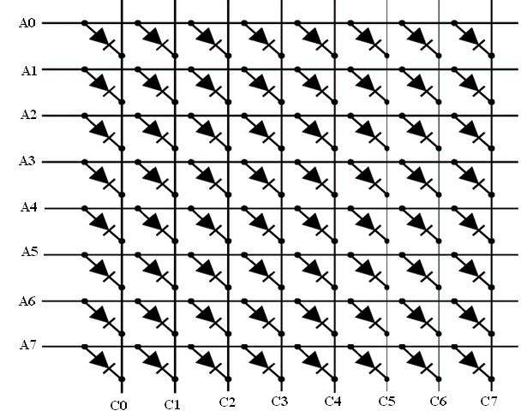
P0
1
0
P1

Slide 7
How to show a fixed LED pattern?
by fixed control byte on P0 and P1

Slide 8
P0
1
1
1
0
0
0
P1

Slide 9
The correct method
display one column in each step
fast scan to make users seeing a fixed pattern

Slide 10
DATA FOR CHARACTER ‘R’
0xc0 - 11000000
0x99 - 10011001
0x99 - 10011001
0xc1 - 11000001
0x89 - 10001001
0x99 - 10011001
0x98 - 10011000
0xff - 11111111

Slide 11









Step 1
Step 5
Final Result
Step 2
Step 6
Step 3
Step 7
Step 4
Step 8

Slide 12
DATA FOR SOME FONTS
0xe7 ,0xc3 ,0x99 ,0x99 ,0x81 ,0x99 ,0x99 ,0xff - 'A‘
0xc0 ,0x99 ,0x99 ,0xc1 ,0x99 ,0x99 ,0xc0 ,0xff - 'B'
0xc3 ,0x99 ,0xfc ,0xfc ,0xfc ,0x99 ,0xc3 ,0xff - 'C'
0xe0 ,0xc9 ,0x99 ,0x99 ,0x99 ,0xc9 ,0xe0 ,0xff - 'D‘
0xc1 ,0x9c ,0x8c ,0x84 ,0x90 ,0x98 ,0xc1 ,0xff - '0‘
0xe7 ,0xe3 ,0xe7 ,0xe7 ,0xe7 ,0xe7 ,0x81 ,0xff - '1‘
0xc3 ,0x99 ,0x9f ,0xc7 ,0xf3 ,0x99 ,0x81 ,0xff - '2‘
0xc3 ,0x99 ,0x9f ,0xc7 ,0x9f ,0x99 ,0xc3 ,0xff - '3‘
0xff ,0x99 ,0xc3 ,0x80 ,0xc3 ,0x99 ,0xff ,0xff - '*‘
0xff ,0xe7 ,0xe7 ,0x81 ,0xe7 ,0xe7 ,0xff ,0xff - '+'

Slide 13
4 – dot matrix’s interface
1 DOT MATRIX - 2 PORTS
4 DOT MATRIX’S - 8 PORTS
AT89S52 - 4 PORTS

Slide 14


Slide 15


Slide 16



Slide 17
SOLUTION
PORT EXPANDER
SHIFT REGISTER
(SERIAL IN PARALLEL OUT )

Slide 18
74HC164
(8-BIT SERIAL-IN PARALLEL OUT SHIFT REGISTER)
Two serial data inputs (DSA and DSB)
Eight parallel data outputs (Q0 to Q7)
Data is entered serially through DSA or DSB and either input can be used as an active HIGH enable for data entry through the other input.
Data is shifted on the LOW-to-HIGH transitions of the clock (CP) input.

Slide 19
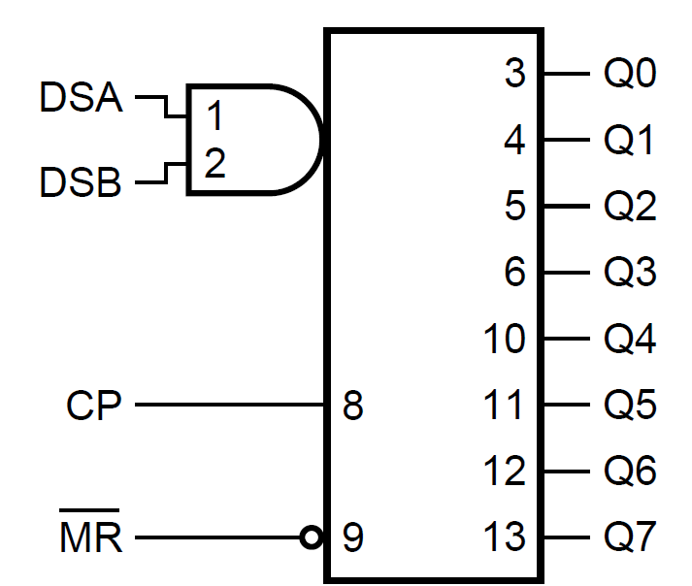
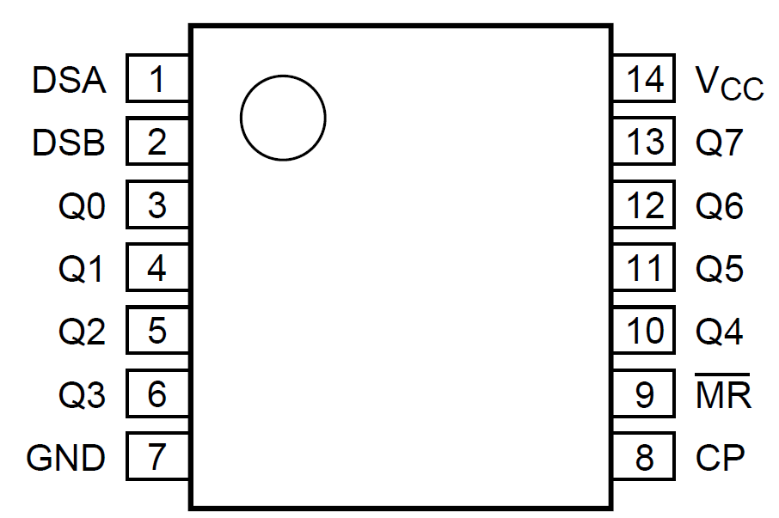
74HC164
(8-BIT SERIAL-IN PARALLEL OUT SHIFT REGISTER)
Logic symbol
Pin configuration

Slide 20
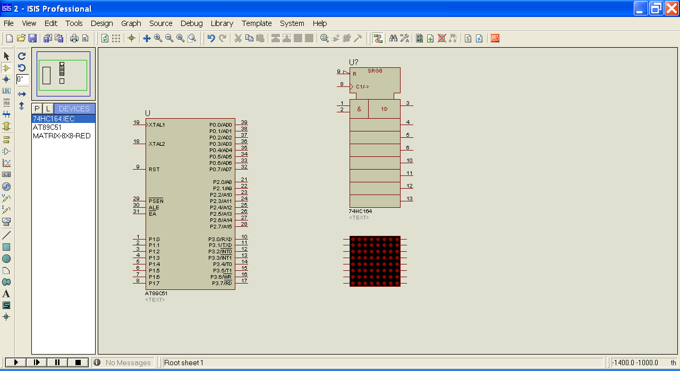

Slide 21
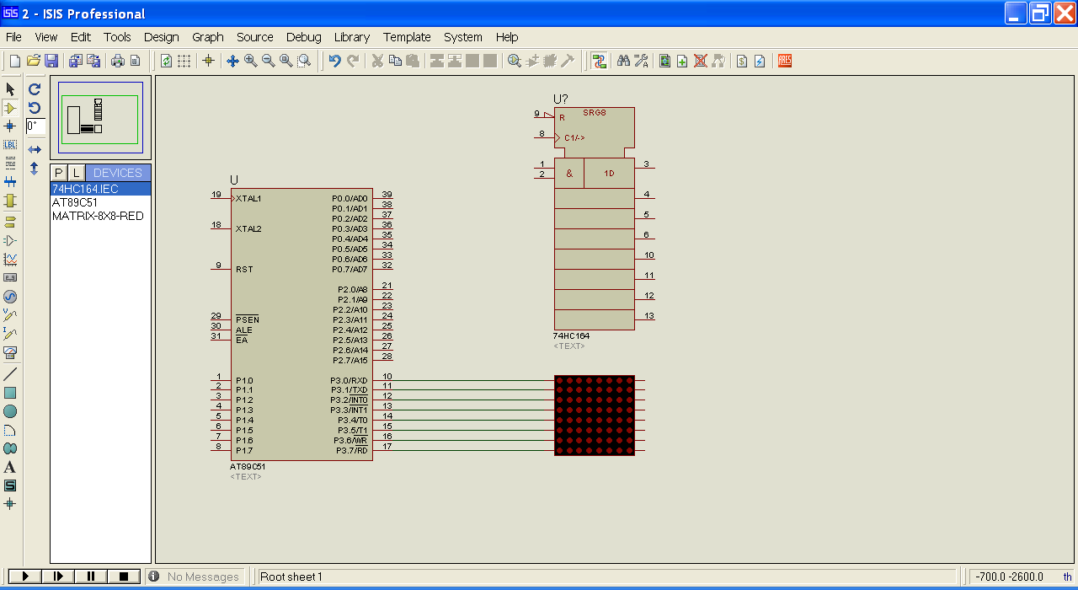

Slide 22
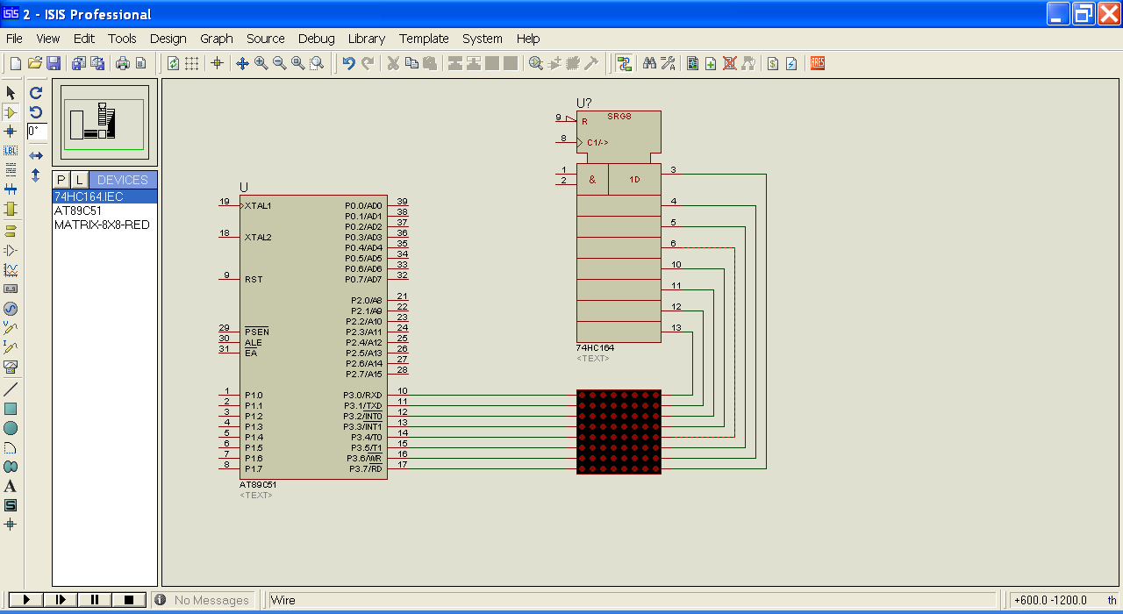

Slide 23
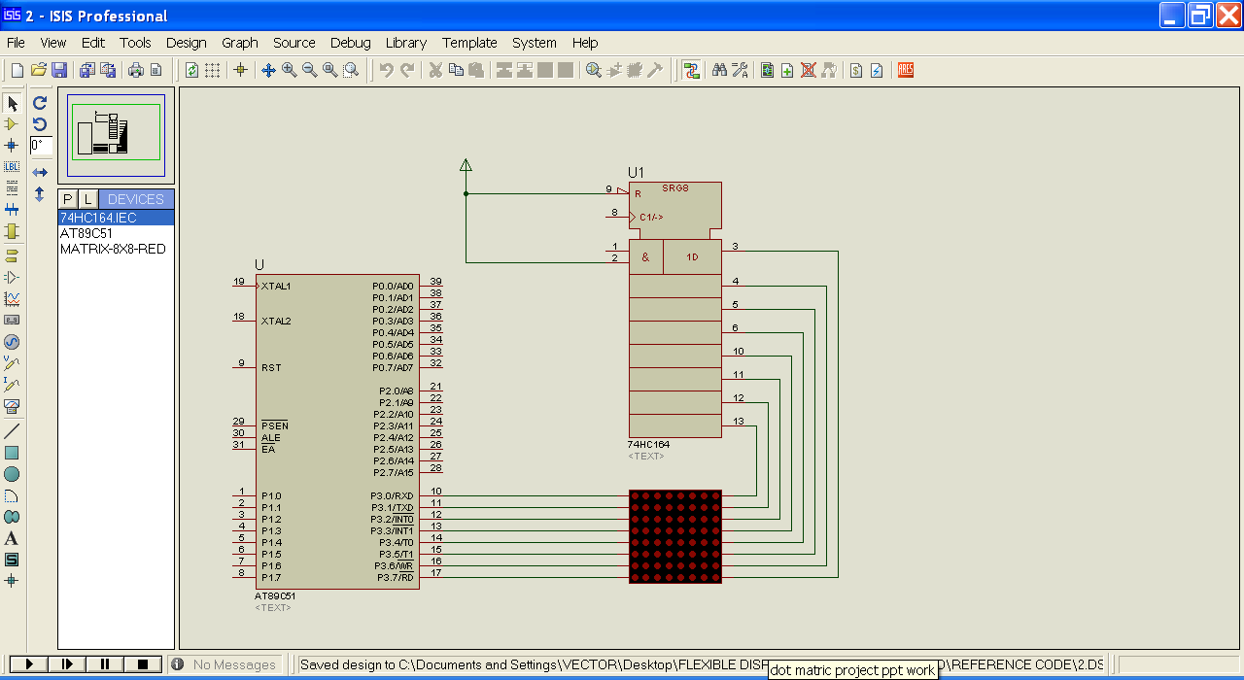

Slide 24
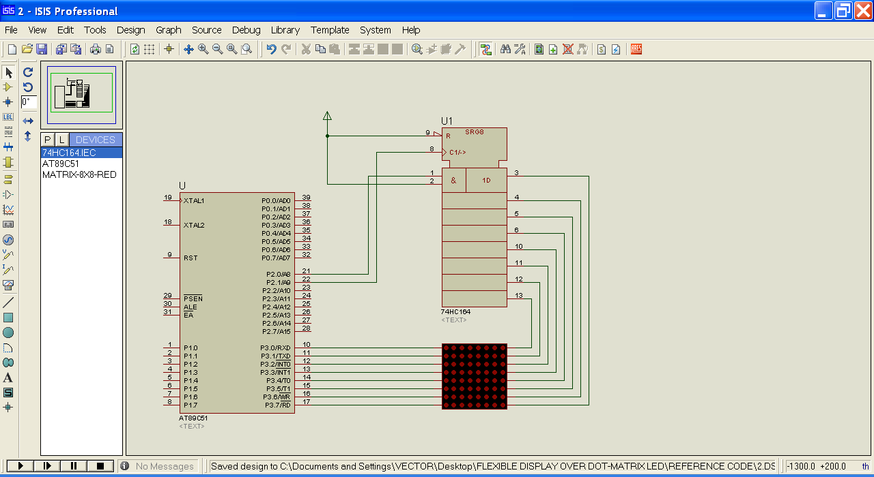

Slide 25
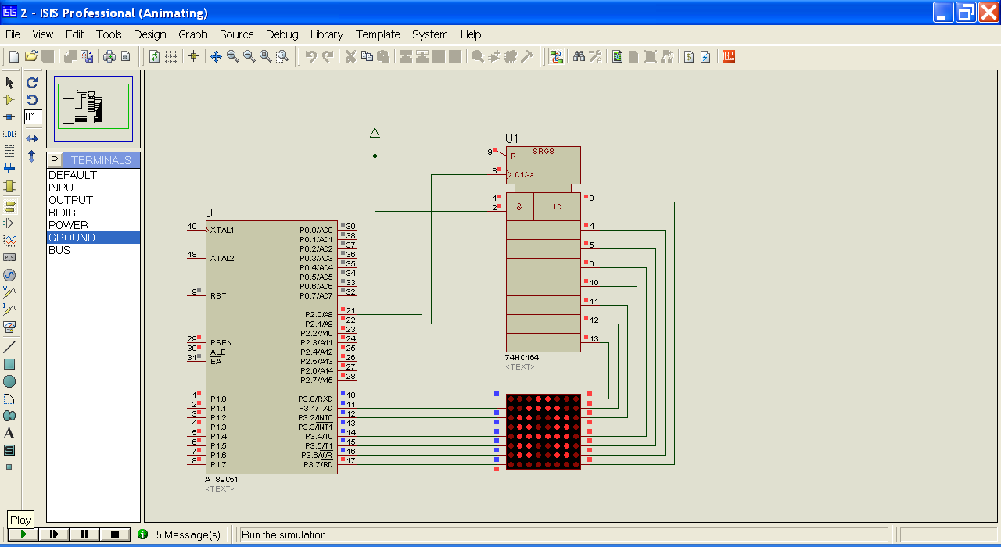

Slide 26
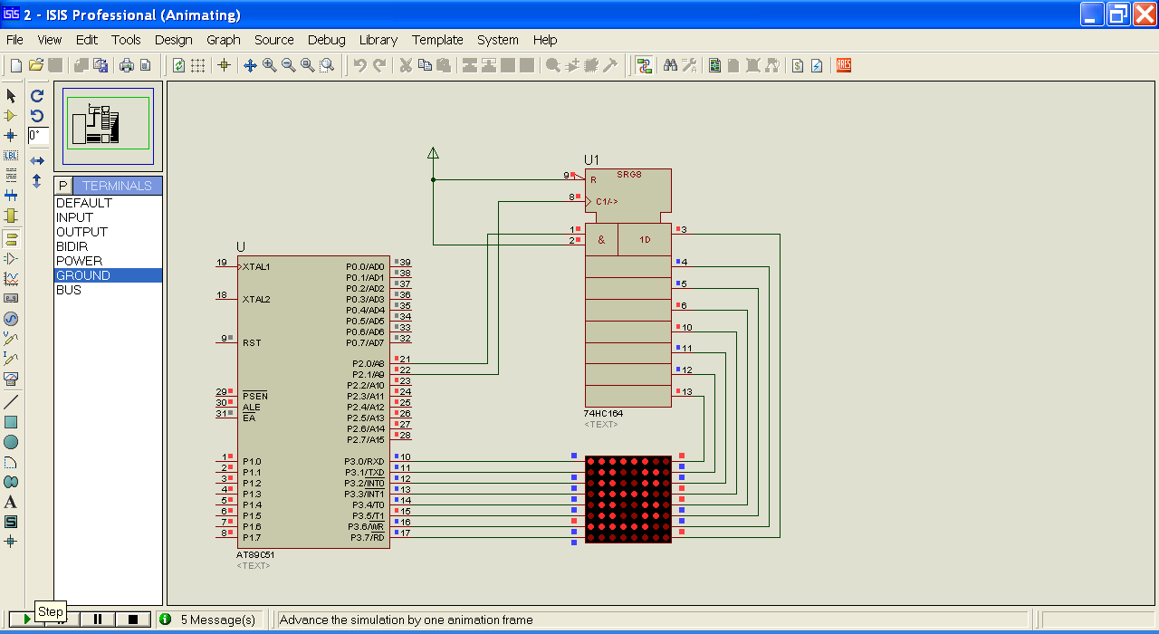

Slide 27


Slide 28


